Slide 1
The Use of Web Ontology Language & Semantic Web For the Digitalization of the Cooley Collection
By Eoin Dalton
20070289

Slide 2
Introduction
Hi laddies and gentlemen,
I am Eoin and today I am hopefully going to explain to you what I done for my 4th year project. The technologies I researched are only in recent years starting to be adapted for information technology needs.
Originally when Dr Larry Stapleton suggested this project he spoke about the semantic web and ontologies and it wasn’t till I took his class this semester that I started to see the benefits of using an ontologies and how these technologies might be used in the digitization of the Cooley collection.

Slide 3
Professor Mike Cooley
Professor Mike Cooley was born in Tuam, Co. Galway in 1934.
Mike Cooley is an innovator in the field of human-centred, socially useful production.
Founding member of AI & Society 1987
The Lucas Plan in the seventies.
In 1981 he won The Right Livelihood Award.

Slide 4
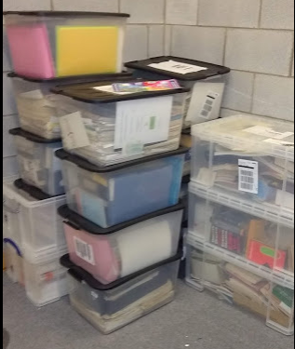
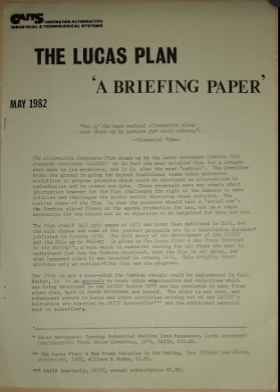
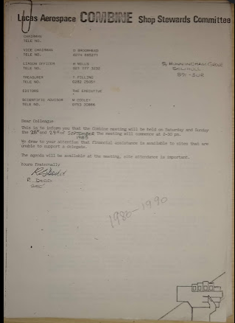
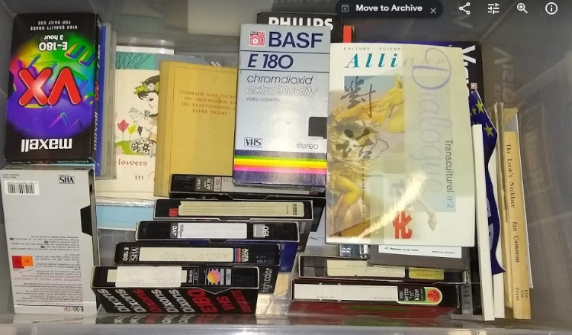
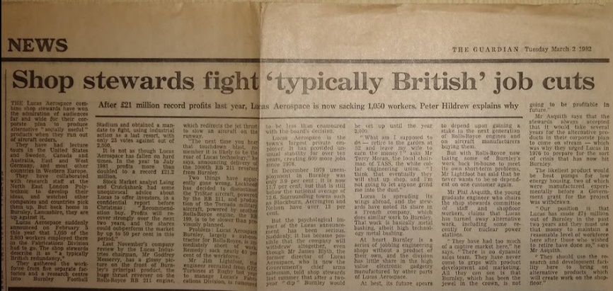
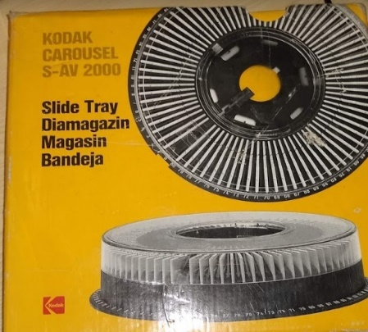
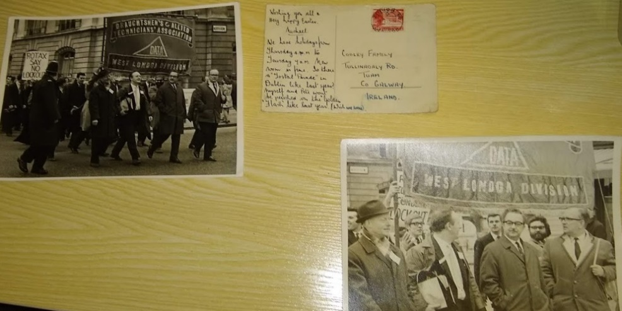
The Cooley Collection

Slide 5
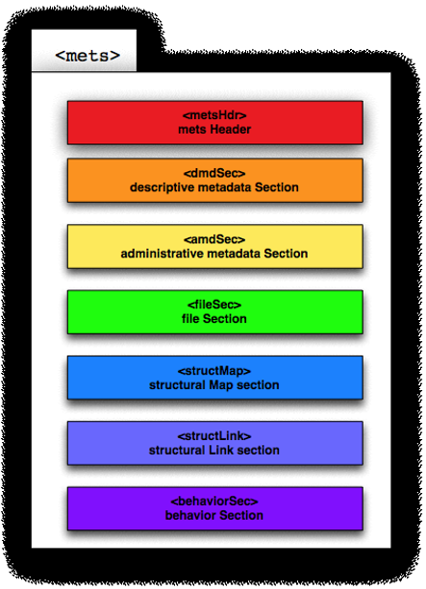
Metadata Encoding Transmission Standard

Slide 6
Why the semantic web & ontologies?
Discover knowledge
Reuse
Interoperability
Relationships

Slide 7
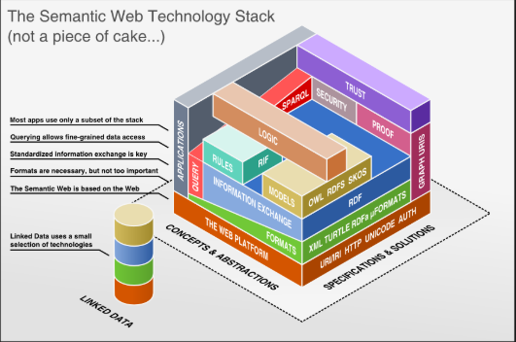
Semantic Web & Technologies

Slide 8
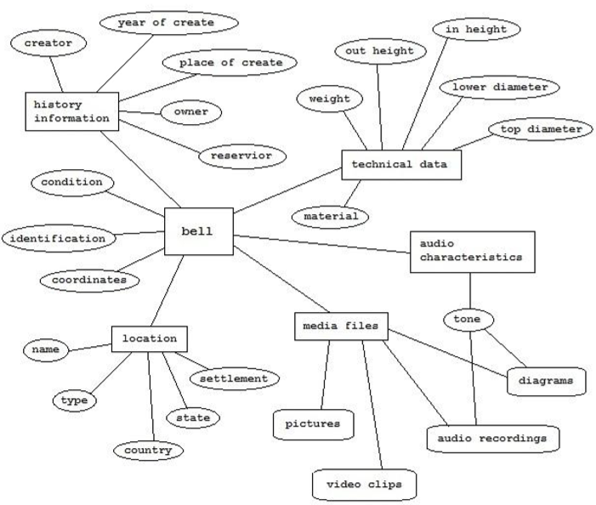
Ontologies

Slide 9
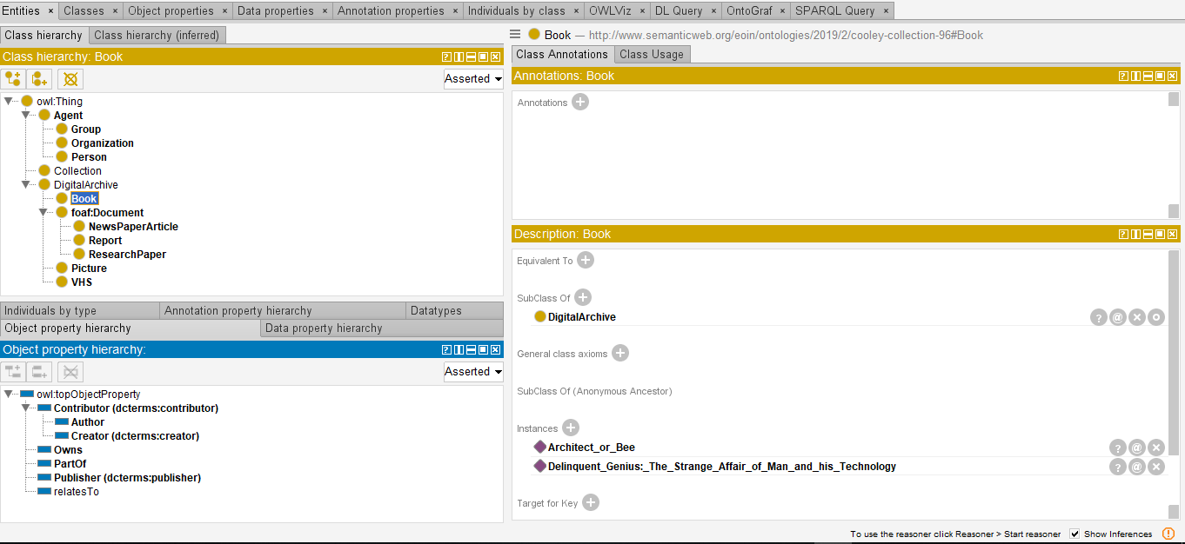
Protégé

Slide 10
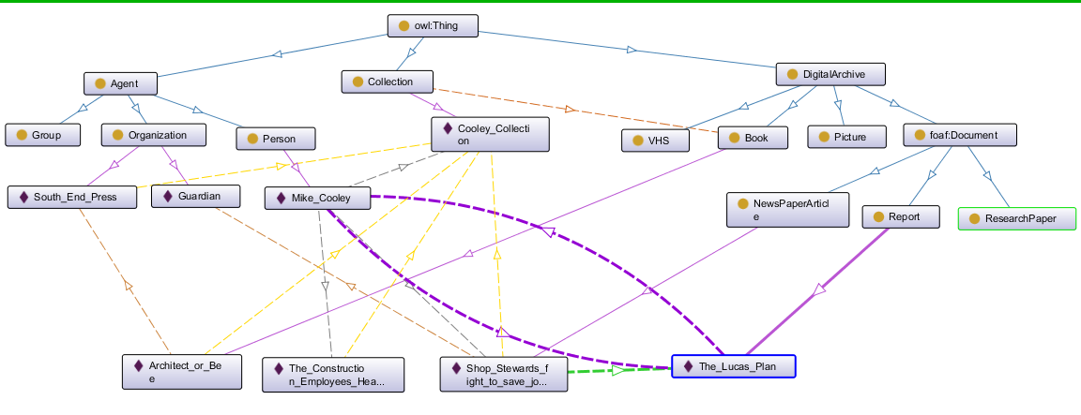
Cooley Collection Ontology

Slide 11
The End
I will now answer any question that you may have.

